Slide 1
Primality Testing
Fermat’s Theorem
&
Euler’s Theorem

Slide 2
Primality Testing
It is an algorithm for determining whether the given input is prime or not.
Algorithm:
Fermat’s Theorem
Euler’s Theorem

Slide 3
Fermat’s Theorem

Slide 4
Fermat’s Theorem (Fermat’s Primality Test)
It is a probabilistic test to determine whether a number is a probable prime.
It states that, if ‘n’ is a prime number, then for every ‘a’, 1 < a <= n-1, then
a^{n-1} ≡ 1 (mod n)
(or)
a^{n} / a ≡ 1 (mod n)
a^{n} ≡ a (mod n)
If a^{n-1} ≡1(mod n), then we declare ‘n’ is the probable prime number.
If a^{n-1} ≡1(mod n), then we declare ‘n’ is the composite number.
A number may pass the Fermat’s test but not a prime, then the number is a Carmichael number.

Slide 5
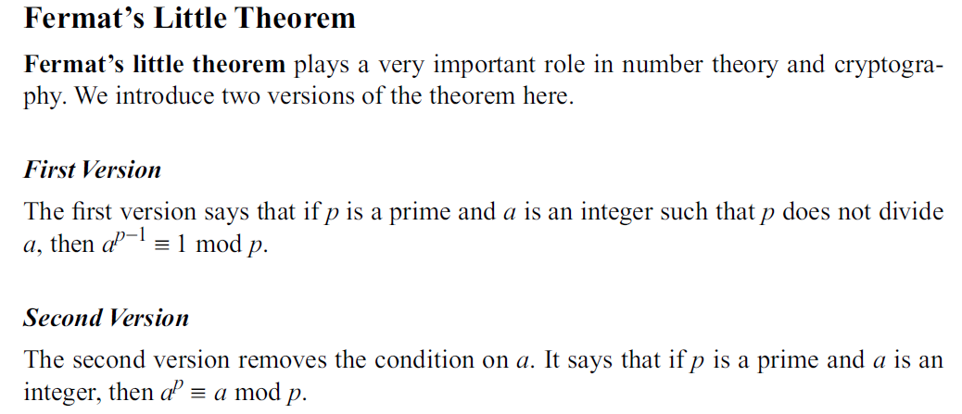

Slide 6
Example - 1
Is 5 prime?
Solution:
Check a^{n-1} ≡1(mod n) [or] a^{n-1} % n = 1 for every ‘a’, 1 < a <= n-1
Given n = 5
pick 1 < a < 4
2⁴ ≡ 1 (mod 5) [or] 2⁴ % 5 = 1
3⁴ ≡ 1 (mod 5) [or] 3⁴ % 5 = 1
4⁴ ≡ 1 (mod 5) [or] 4⁴ % 5 = 1
Here the condition is always true, therefore the given number 5 is prime.
True for all the cases

Slide 7
Algorithm
Inputs: n - a value to test for primality where n>3;
k - a parameter that determines the number of times to test for primality.
Output: composite if ’n’ is composite, otherwise probably prime.
Repeat k times:
Step 1: Pick ’a’ randomly in the range [2, n − 2]
Step 2: If a^{n-1} ≡1(mod n), then return composite.
Step 3: If composite is never returned then return probably prime.
NOTE: The a values 1 and n-1 are not used as the equality holds for all n and all odd n respectively, hence testing them adds no value.

Slide 8
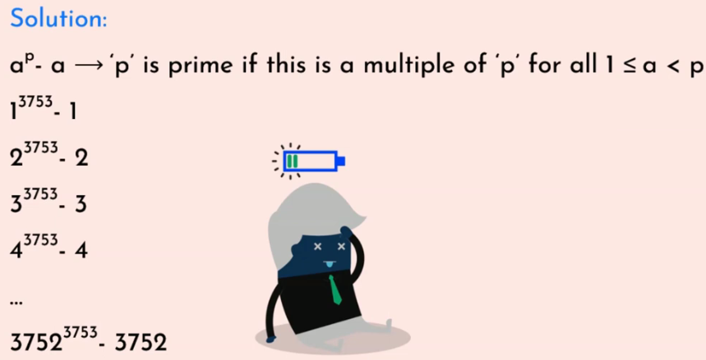
Drawbacks of Fermat’s theorem
Complex for large numbers.
Example: is 3753 prime?

Slide 9
Drawbacks of Fermat’s theorem
Lack of accuracy.
Example: is 561 prime?
Actual answer is 561 is a composite number and not a prime number, but Fermat’s primality test will say 561 is a prime number.

Slide 10
Exercise
Find whether 11 is prime using Fermat’s theorem.

Slide 11
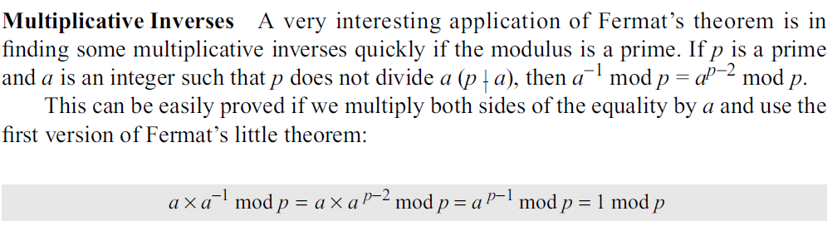

Slide 12
Euler’s Totient (Phi) function

Slide 13
Euler’s Totient (Phi) function
Denoted as φ(n).
φ(n) = Number of positive integers less than ‘n’ that are relatively prime to ‘n’ .
Counts the number of integers from 1 and up to n-1 which are co-prime to n.
NOTE: x and y are co-prime if GCD(x,y)=1

Slide 14
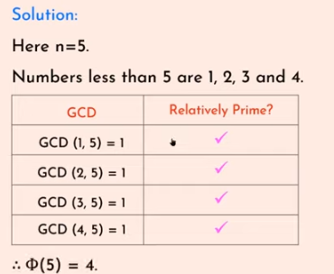
Example - 1
Find φ(5).

Slide 15
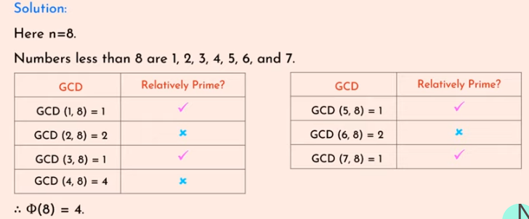
Example - 2
Find φ(8).

Slide 16
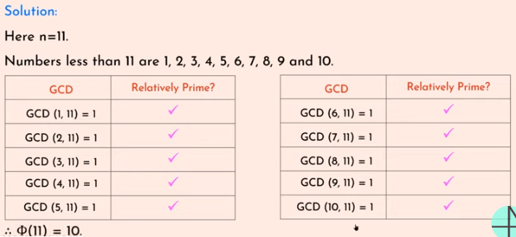
Example - 3
Find φ(11).

Slide 17
Exercise
Find φ(369) and φ(372).

Slide 18

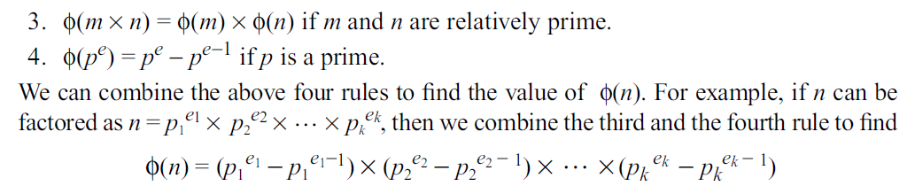

Slide 19
Properties of Euler’s Totient Function
If p is a prime number, then Φ(p) = p -1
Example:
Find Φ(7).
Here 7 is a prime number then
Φ(7) = 7-1
= 6.

Slide 20
Properties of Euler’s Totient Function
2. If p is a prime number and k>=1, then
Φ(p^{k})=p^{k}-p^{k-1}
Example:
Find Φ(8).
Φ(8) = Φ(2³) = 2³-2³⁻¹
= 8 - 4
= 4

Slide 21
Properties of Euler’s Totient Function
3. If a and b are relatively prime
Φ(ab)= Φ(a)* Φ(b)
Example:
Find Φ(15).
Φ(15)= Φ(3)* Φ(5)
= 2*4
= 8

Slide 22
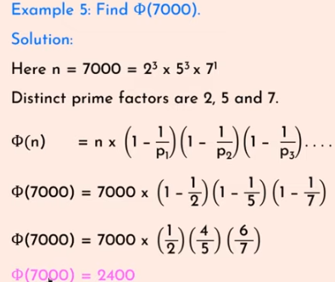
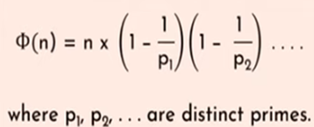
Properties of Euler’s Totient Function
4. If n = a x b,

Slide 23
Exercise
Φ(20)
Φ(21)
Φ(19)
Φ(45)
Ans
Φ(20) = 8
Φ(21) = 12
Φ(19)= 18
Φ(45)=24

Slide 24
Euler’s Theorem

Slide 25
Euler’s Theorem
Euler’s theorem states that for every possible integers ‘a’ and ‘n’ are said to be co-prime then,
a ^{Φ(n)} ≡ 1 (mod n )
Example:
Prove Euler’s theorem hold true for a=3 and n=10.
Given a=3 and n=10
Step 1. Check a ^{Φ(n)} ≡ 1 (mod n ), then 3^{Φ(10)} ≡ 1 (mod 10)?
Step 2. Find Φ(10) = Φ(2) * Φ(5) = 1*4 = 4
Step 3. 3⁴ ≡ 1mod 10
Step 4. 81 ≡ 1 mod 10
Step 5. 1 = 1
Therefore, Euler’s theorem holds true for a=3 and n=10.

Slide 26
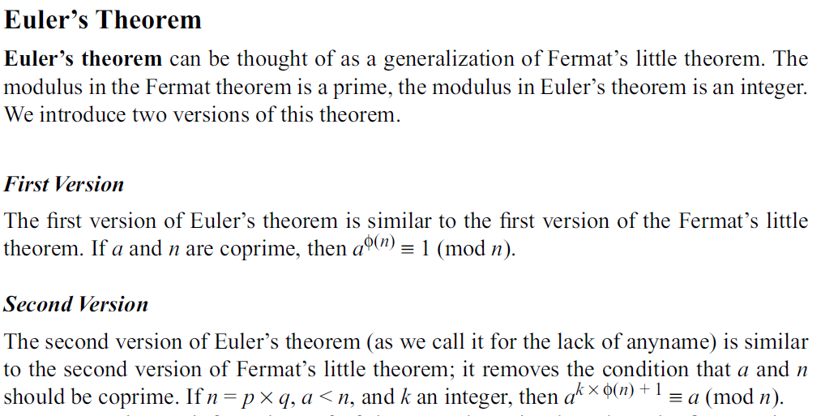

Slide 27
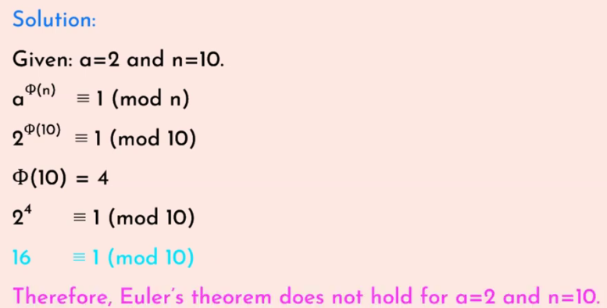
Example - 2
Does Euler’s theorem hold true for a = 2 and n = 10.

Slide 28
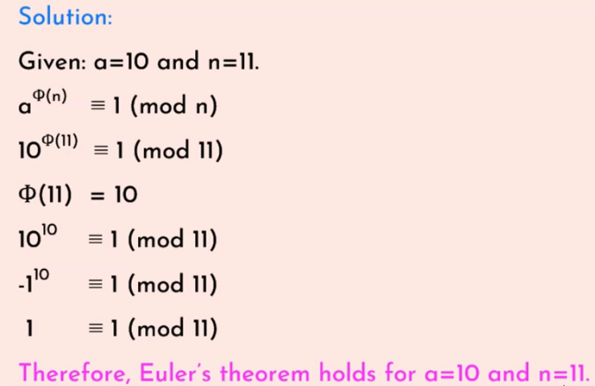
Example - 3
Does Euler’s theorem hold true for a = 10 and n = 11.
Notes:
10 is -1 shortage from 11 so we cant write it as -1¹⁰ ≡ 1 (mod 11) and -1 to the power odd number v ll get -1 itself since -1 to the power even number

Slide 29
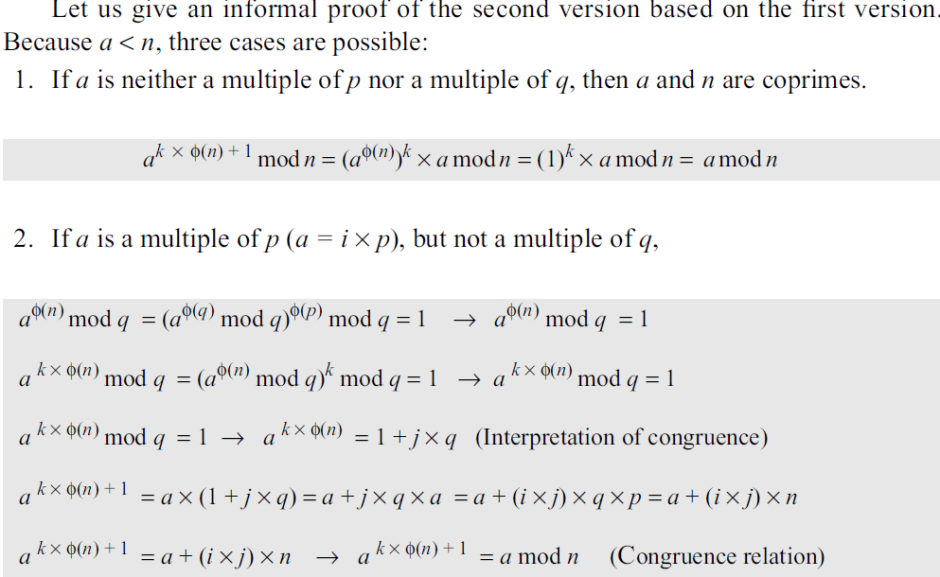

Slide 30
Exercise
Prove Euler’s theorem does not hold for a = 11 and n = 33.

Slide 31

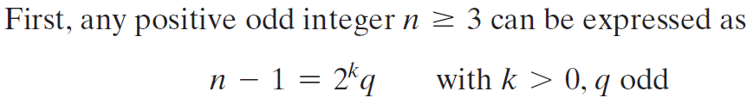
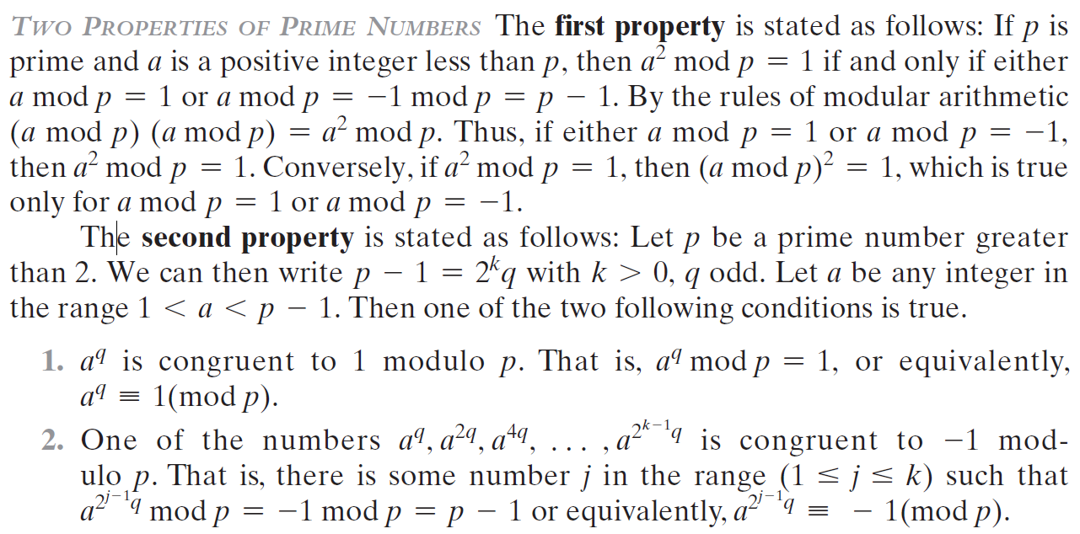

Slide 32
